Slide 1
Public Health in Simcoe Muskoka
Charles Gardner, Medical Officer of Health
Sue Surry, Associate Medical Officer of Health
Lisa Simon, Associate Medical Officer of Health

Slide 2

Presentation Overview
An overview of public health, focusing on Simcoe Muskoka
Case studies re joint work between public health and family medicine:
Gestational Weight Gain
Clinical Service Programs:
  Vaccine Preventable Diseases
  Communicable Disease
  Sexual Health
Community water fluoridation campaign in Orillia

Slide 3
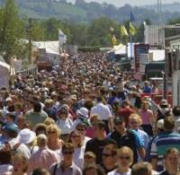
Public Health Is…
A 160 year old movement
Strategies focused on populations
To prevent disease and injury, and protect and promote health

Slide 4
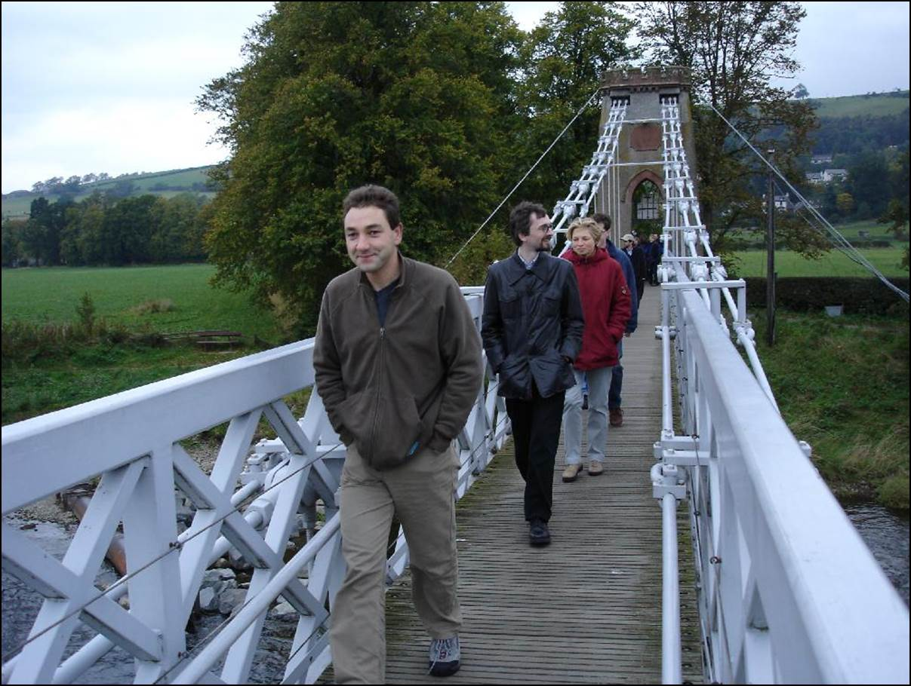
Taking Action On The Things That Make Us Healthy
Environment
  physical, social, political, economic
Behavior
  smoking, diet, physical activity, injuries, sexual health
Human Biology
  age, gender, family history
Health Care
  prevention, treatment,
  rehabilitation

Slide 5
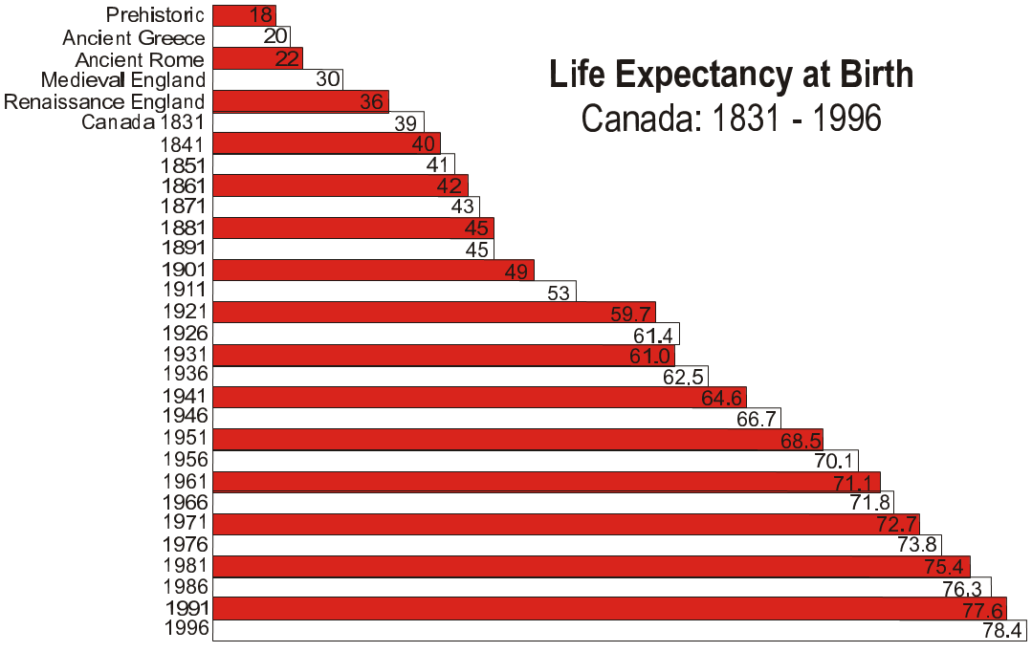
The Impact of Public Health: Life Expectancy Trends
The Urban Futures Institute: Research on Population, Community Change and land Use in British Columbia

Slide 6

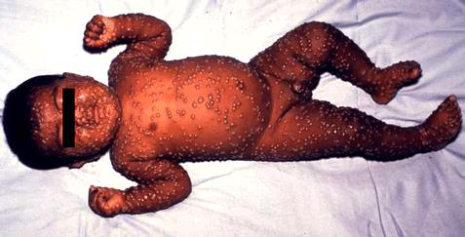
The Impact of the Public Health Movement
Beginnings of public sanitation movement in the 19th century
  Municipal water sanitation and sewage systems
  Child universal education
  Improving incomes, housing, nutrition,
  Working conditions
  Infection control practices:
    Water and food safety
    Health care
  Vaccination (smallpox)
Dr. John Snow, cholera
and the Broad St. pump

Slide 7
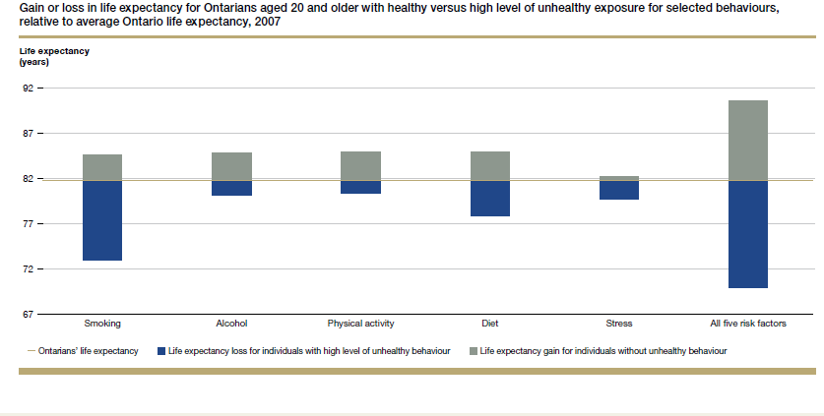
We have room to further increase life expectancy:
7 more years with healthy behaviour…
Source: SEVEN MORE YEARS: The impact of smoking, alcohol, diet, physical activity and stress on health and life expectancy in Ontario. Institute for Clinical Evaluative Sciences, Public Health Ontario

Slide 8
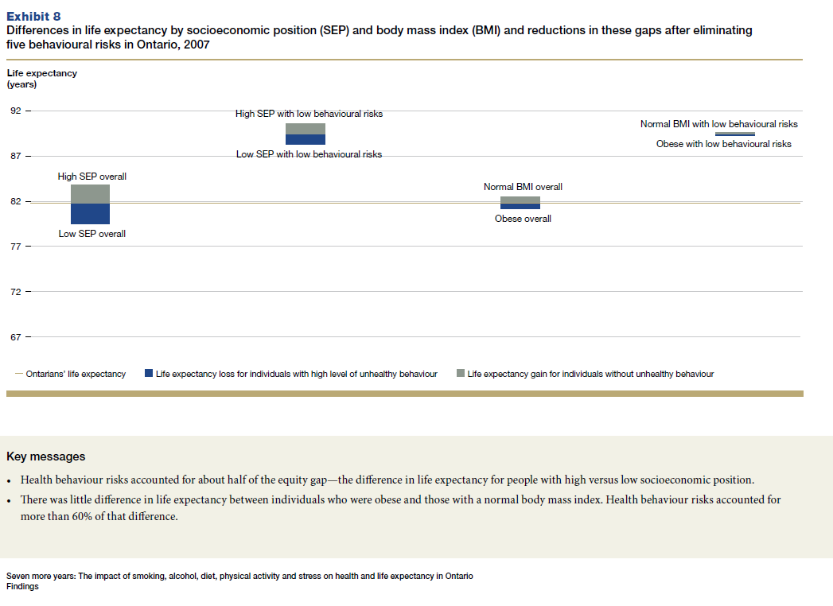
And 4 more years with health equity.
Source: SEVEN MORE YEARS: The impact of smoking, alcohol, diet, physical activity and stress on health and life expectancy in Ontario. Institute for Clinical Evaluative Sciences, Public Health Ontario

Slide 9
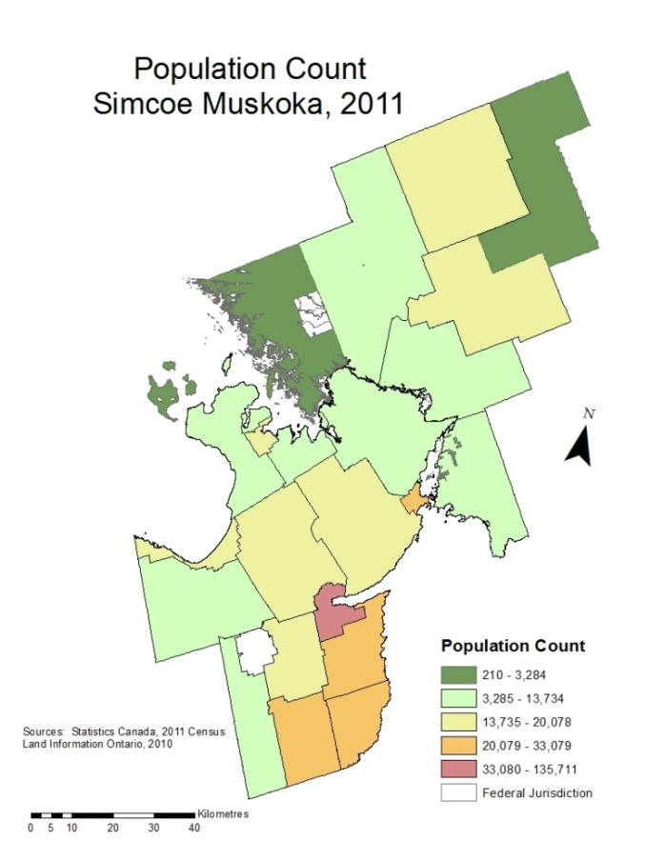
Simcoe Muskoka
Servicing 504,110 people (2011 Census)
8,797 square kilometers
Population increase 5% from 2006 to 2011
Four upper tier / single tier municipalities
(26 municipal councils)

Slide 10
The Ontario Public Health Standards & Protocols

Slide 11

Water
Drinking
  To ensure the drinking water the public has access to is potable by:
    assessing risk in reports of adverse results
    responding to identified risks and hazards
    informing and educating the public
    Inspection of drinking water systems

Slide 12

Food Safety Program
2011 Highlights
  Over 6000 inspections of high, medium and low-risk premises
  Responded to 398 consumer complaints
  21 charges laid under Food Premises Regulation
  1200 food handlers pass food safety certification course
  Food safety calendar printed for distribution to over 1900 high and medium-risk premises in Simcoe Muskoka
  Issued over 700 Special Event Permits

Slide 13
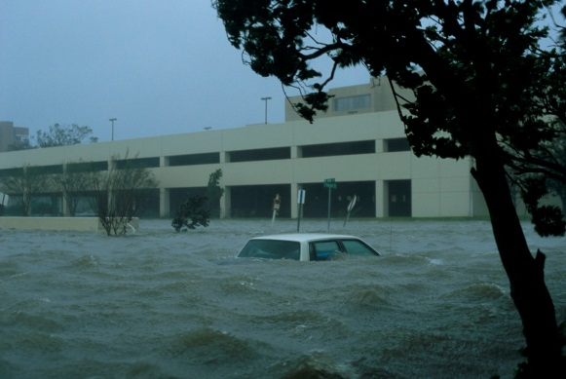
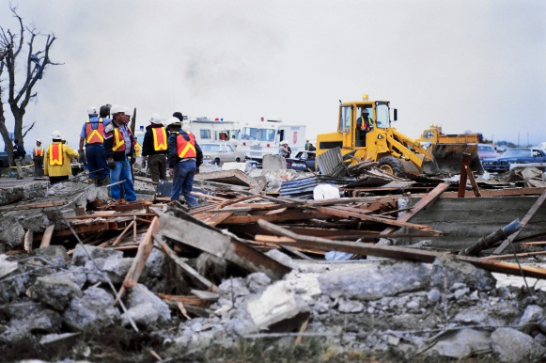
Emergency Management
External emergency planning with partnerships/committees:
  municipalities, health sector coordination, other health units, Red Cross & Social Service Agencies.
Response experiences:
  H1N1 influenza pandemic, G8 Summit, train derailment, tornadoes/storm events, floods, power outages, chemical fires.

Slide 14
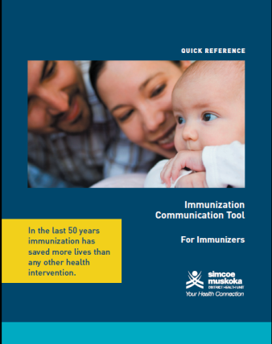
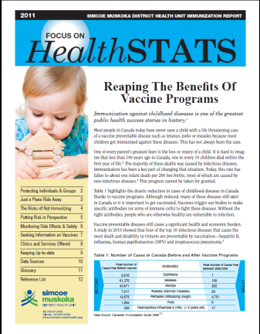
Immunization Provision and Promotion
7,629 vaccinations delivered in 7 health unit office clinics (i.e. multiple clinics offered in each of our offices)
11,517 influenza vaccinations delivered in 53 public clinics
20,252 HBV, HPV and Meningococcal vaccinations delivered in school clinics
Thus 39,398 total vaccinations delivered by SMDHU staff in 2011
Most early childhood vaccines provided by family physicians (supplied and guided by public health)
Notes:
Ontario Early Year Centres

Slide 15
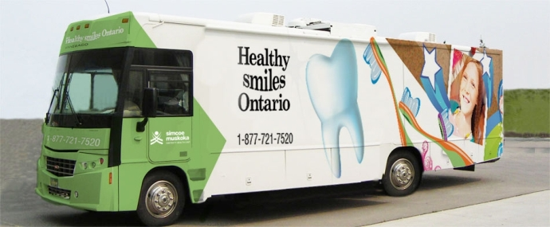
Dental services provided in Simcoe Muskoka
Healthy Smiles Ontario clinics provide full dental services to low-income families and others on government-funded dental benefits.
Full treatment services at the health unit’s Barrie clinic location.
Healthy Smiles Ontario bus visits communities throughout Simcoe Muskoka.
Oral health surveillance in schools, and community reporting.
Notes:
Demand continues to grow for service in Orillia, Midland, Gravenhurst and Wasaga Beach/Collingwood. In communities where dentists accept publically funded dental programs such as CINOT,OW, ODSP and HSO demand is low for our services. Angus and Bradford we have had low uptake despite targeted promotion of our services.

Slide 16
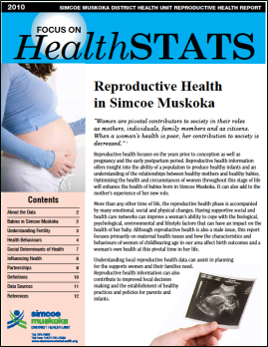
Reproductive Health Program
Preconception Health
  An increased proportion of individuals in their reproductive years are physically, emotionally, and socially prepared for conception
Healthy Pregnancies and
Birth Outcomes
  An increased proportion of pregnant women and their families adopt practices to support a healthy pregnancy
Preparation For Parenthood
  An increased proportion of expectant parents are physically, emotionally, and socially prepared to become parents

Slide 17
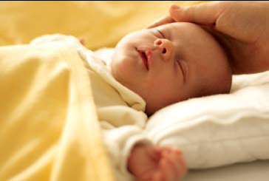
HBHC Program Mandate & Scope
Province-wide voluntary prevention/early intervention program
Goals:
  To promote optimal physical, cognitive, communicative and psychosocial development in children who are at risk prenatal to age 6 years
  To act as a catalyst for a coordinated, effective, integrated system of services and supports for healthy child development and family wellbeing through the development of a network of service providers and participation in community planning activities

Slide 18
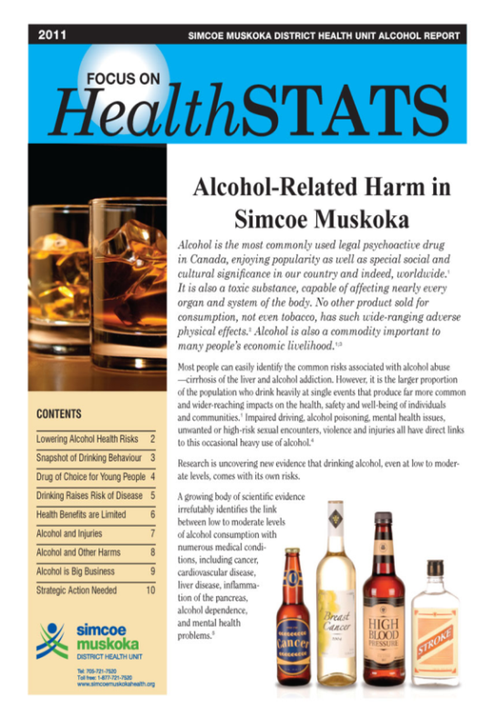
Injury and Substance Misuse Prevention Program
Injury
  Road and off road safety
  Falls across the lifespan
  Working towards a Regional Falls Prevention Strategy for older adults
Substance Misuse
  Alcohol Focus Report
  Work with all levels of government on alcohol
  control measures
  Working towards a Drug and Alcohol Strategy
Notes:
Regional Falls Prevention Strategy for older adults:
SMDHU Co-chair of the Staying Independent FallsPrevention Coalition and working with the NS LHIN Integrated Regional Falls Prevention Program and others
Work with Municipalities on Alcohol Control Strategies:
Workshop in the Fall - strategies municpalities can use to mitigate alcohol related harm with respect to recent changes to the Liquor Licence Act
Drug and Alcohol Strategy for Simcoe Muskoka
SMDHU spearheaded this with CAMH
Other program examples
Child passenger safety
Helmet use
Promotion of low risk drinking guidelines
Municipal Alcohol Policy
Just Drive Campaign
18

Slide 19

Chronic Disease Prevention Program
Tobacco Program
  Preventing young people from smoking
  Protecting people from exposure to second-hand smoke
  Supporting people to quit smoking
  Enforcing the Smoke Free Ontario Act
Healthy Lifestyle Program
  Promoting healthy eating and food security
  Promoting physical activity
  Reviewing official and other municipal plans related to health
Notes:
Tobacco program examples – health promotion and enforcement strategies work together to achieve tobacco free objectives
Preventing young people from smoking
Tobacco Free Sports and Recreation Policies
Chew Tobacco Awareness Campaign
Smoke Free School Property Education and Enforcement
Tobacco Vendor Education and Inspection
Protecting people from exposure to second hand smoke
Smoke-free Outdoor Spaces Bylaws
Smoke-Free Multi-Unit Dwellings Policies
Workplace and Indoor Public Places Education and Enforcement
Supporting people to quit smoking
Cessation counseling to pregnant/postpartum women with children up to the age of 6 (and household partners)
Workplace supports
Promotion of provincial Driven to Quit Cessation Contest
CDP-Healthy Lifestyle Program Examples
Healthy Eating and Food security
School Food and Beverage Policy support
Eat Smart! Recreation Program
Nutrition Tools for Schools
Student Nourishment Programs
Food Security
Nutritious Food Basket Survey
Food & Agriculture Charter development
Physical Activity and Built environment
Official and other municipal plan reviews
Active Transportation Workshop
Numerous community committees re HE , FS and PA
19

Slide 20
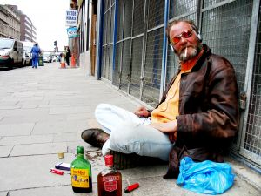


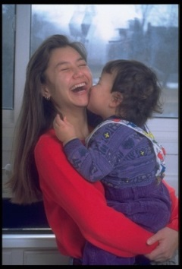


The Social and Economic
Determinants of Health
Access to education, meaningful employment, sufficient income
Secure access to basic material needs – living wage, housing, transportation (community design)
Access to social networks / supports
(community design)
Early child development
(prenatal factors, positive
parenting, secure and
stimulating environment)
Notes:
Early childhood is defined by who as including prenatal to 8 years of age. Life course concept - intersects with other determinants

Slide 21

Final Thoughts
Improving the health of the public is achieved through joint work with many partners in and out of the health care system – most commonly with family physicians.
The Simcoe Muskoka District Health Unit continues to be committed to excellence in public health.

Slide 22
Clinical Services at SMDHU
Lisa Simon MD, MPH, CCFP, FRCPC
Associate Medical Officer of Health

Slide 23
Clinical Services Team Structure
Vaccine Preventable Disease Team
  Goal: To reduce or eliminate the burden of vaccine preventable diseases.
Communicable Disease Team
  Goal: To prevent or reduce the burden of infectious diseases of public health importance
Sexual Health Team
  Goal: To prevent or reduce the burden of sexually transmitted infections and blood-borne infections.
  Goal: To promote healthy sexuality.
Notes:
Goals from OPHS
Will discuss example activities from each program area, in order to:
Understand more fully some common and emerging public health infectious diseases issues seen, and actions taken, through cases in family and emergency medicine practice.
To describe some of the roles of the Simcoe Muskoka District Health Unit in infectious disease issues faced by clinicians.

Slide 24
Examples of Vaccine-Preventable Disease Team Activities

Slide 25
School Immunization Programs
Hepatitis B (Grade 7)
  Only 2 immunizations are required vs 3 for the adult schedule
Meningococcal C-ACYW-135 (Grade 7)
HPV (Grade 8 girls)
  Uptake remains lower than optimal – multiple reasons, but still impacted by initial negative media and perceived sexual promiscuity associated with being vaccinated
  2013 US estimates of reduction in HPV prevalence following intro of vaccine
  What if a parent of one of your male adolescent patients asks you for the HPV vaccine for their son?
Notes:
Reduction in Human Papillomavirus (HPV) Prevalence Among Young Women Following HPV Vaccine Introduction in the United States, National Health and Nutrition Examination Surveys, 2003–2010
J Infect Dis. (2013) 208 (3): 385-393. doi: 10.1093/infdis/jit192 First published online: June 19, 2013
Correspondence: Lauri E. Markowitz, MD, Centers for Disease Control and Prevention, 1600 Clifton Rd, MS E-02, Atlanta, GA 30333 (lem2@cdc.gov).
Abstract
Background. Human papillomavirus (HPV) vaccination was introduced into the routine immunization schedule in the United States in late 2006 for females aged 11 or 12 years, with catch-up vaccination recommended for those aged 13–26 years. In 2010, 3-dose vaccine coverage was only 32% among 13–17 year-olds. Reduction in the prevalence of HPV types targeted by the quadrivalent vaccine (HPV-6, -11, -16, and -18) will be one of the first measures of vaccine impact.
Methods. We analyzed HPV prevalence data from the vaccine era (2007–2010) and the prevaccine era (2003–2006) that were collected during National Health and Nutrition Examination Surveys. HPV prevalence was determined by the Linear Array HPV Assay in cervicovaginal swab samples from females aged 14–59 years; 4150 provided samples in 2003–2006, and 4253 provided samples in 2007–2010.
Results. Among females aged 14–19 years, the vaccine-type HPV prevalence (HPV-6, -11, -16, or -18) decreased from 11.5% (95% confidence interval [CI], 9.2–14.4) in 2003–2006 to 5.1% (95% CI, 3.8–6.6) in 2007–2010, a decline of 56% (95% CI, 38–69). Among other age groups, the prevalence did not differ significantly between the 2 time periods (P > .05). The vaccine effectiveness of at least 1 dose was 82% (95% CI, 53–93).
Conclusions. Within 4 years of vaccine introduction, the vaccine-type HPV prevalence decreased among females aged 14–19 years despite low vaccine uptake. The estimated vaccine effectiveness was high.

Slide 26
Immunizations and school suspensions
Health Unit (HU) required under the Immunization of School Pupil’s Act (ISPA) to collect and maintain up-to-date records of immunization for every child registered in school in Simcoe and Muskoka
Under ISPA, parents required to provide HU with proof of completed immunization for following diseases or with appropriate documentation if choose not to immunize child:
  Diseases: Diphtheria, Tetanus, Polio, Measles, Mumps and Rubella
  Documentation: Form 1 - Medical Exemption, or Form 2 - Statement of Conscience or Religious Belief Affidavit
  May be suspended if one of the above aren’t provided
Notes:
Please tell your patients to inform HU each time they get vaccinations, up to and including 14-16 yr Tdap booster

Slide 27
Adverse Events Following Immunization (AEFIs)
Notes:
Report only events which cannot be attributed to co-existing conditions.

Slide 28
Vaccine Hesitancy
Understand the specific vaccine concerns of the parent: Use motivational interviewing, ie, questions that are client-centred, semi-directive and aimed at changing behaviour
Stay on message and use clear language to present evidence of vaccine benefits and risks fairly and accurately, e.g. “Vaccines are safe and effective, and serious disease can occur if your child and family are not immunized.”
Inform parents about the rigour of the vaccine safety system
Address the issues of pain with immunization
  Reducing the pain of childhood vaccination: An evidence-based clinical practice guideline. CMAJ 2010;182(18):1989-95.
Do not dismiss children from your practice because parents refuse to immunize
Working with vaccine-hesitant parents. MacDonald NE, Finlay JC; Canadian Paediatric Society Infectious Diseases and Immunization Committee. Paediatr Child Health 2013;18(5):265-7
Notes:
ASK approach: Acknowledge your parent’s concerns, Steer your conversation, Knowledge

Slide 29
VPD Resources for Clinical Practice
Available on SMDHU’s soon-to-be-revised web portal for primary care providers:
  MOHLTC publicly funded immunization schedule
  Canadian immunization guide (online) and new NACI statements
  Patient resources:
    SMDHU vaccine fact sheets
    SMDHU Focus on HealthSTATS 2011 report on vaccines (& references)
  And more…

Slide 30
Examples of Communicable Disease
Team Activities

Slide 31
Communicable Diseases Reportable to Public Health
Notes:
Timely reporting of communicable diseases is mandated and essential for their control. If you suspect or have
confirmation of the following specified Reportable Diseases or their etiologic agents, (as per Ontario Regulation
559/91 and amendments under the Health Protection and Promotion Act, R.S.O. c.H.7) please report them to
the local Medical Officer of Health.
Note: Diseases highlighted (and influenza in institutions) should be reported immediately to the Medical Officer of Health
by telephone. Other diseases can be reported by the next working day by fax, phone, or mail.
Labs are also mandated to report to us.

Slide 32
Advising on chemoprophylaxis for contacts of select CDs – examples:
Pertussis
Invasive Group A Strep
Invasive meningococcal disease
Haemophilus influenza B
Measles
Hepatitis B
HIV
Influenza outbreaks

Slide 33
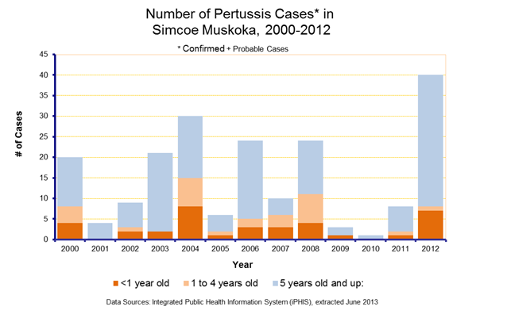
Notes:
Pertussis generally occur in clusters and as you can see from the graphs below, it’s not unusual for us to have 20-30 cases in a year. Last calendar year (2012), we had 40 confirmed + probable, most of which occurred in June, July and August but this was an all time high both locally and provincially so likely part of the 4-6 year cycle.

Slide 34
Pertussis: Management of Contacts
Period of Communicability: Highly communicable in the early catarrhal stage and beginning of the paroxysmal stage (first 2 weeks) and then communicability gradually decreases and becomes negligible in about 3 weeks. No longer communicable after 5 days of effective treatment.
There is no evidence that antibiotic prophylaxis of contacts changes the epidemic course of pertussis in the community, therefore, it is only recommended for the following contacts of confirmed pertussis cases who are:
  household contacts (including attendees at family daycare centers) where there is a vulnerable person defined as an infant < 1 year of age [vaccinated or not] or a pregnant woman in the third trimester.

Slide 35
Pertussis: Management of Contacts (cont.)
  For out of household exposures, vulnerable persons, defined as infants less than one year of age regardless of immunization status and pregnant women in their third trimester who have had face-to-face exposure and/or have shared confined air for > 1 hour.
The local health unit will identify persons who meet the contact definition above and advise them about chemoprophylaxis and refer them to their physician for prescriptions. Prophylaxis is the same as treatment (macrolide) and should be given within 21 days after exposure.
Notes:
Pertussis challenges:
Usually a large number of contacts because of long period of communicability and many cases are in teenagers and children
Determination of who to receive prophylaxis
NP swabs are not always used to diagnose by clinicians
Vaccination
Others

Slide 36
Public Health - CD Resources Useful for Clinical Practice
General:
  Red Book (AAP)
  Ontario Public Health Standards (OPHS) ID protocol – Appendix for each reportable disease (free online)
  SMDHU communicable disease fact sheets
TB:
  Tuberculosis: Information for Health Care Providers (Lung Association, free online)
  Canadian TB Standards, 7th edition (released June 2013)
Key updates on SMDHU website and through HealthFAX
  Increased disease activity, emerging infections, etc.
Notes:
This list is not inclusive of the large number of resources/guidelines specific to infectious disease aspects of clinical practice.

Slide 37
Examples of Sexual Health Team activities

Slide 38
Sexually Transmitted Infections
A 35 y.o. woman is a patient in your practice. During routine prenatal testing, she tests positive for gonorrhea through a cervical PCR swab.
As a family physician in Simcoe-Muskoka, what are your responsibilities to the woman, her sexual contacts and to the public health unit? How can the public health unit assist you?

Slide 39
New: PHO Guidelines for Testing and Treatment of Gonorrhea in Ontario, 2013
Select messages:
Issue:
  Emergent multi-drug resistant gonorrhea
Testing:
  Culture is preferred option for laboratory testing of symptomatic patients
Treatment:
  Oral cefixime is no longer first line therapy for the treatment of gonorrhea in Ontario
  New first line therapy: Ceftriaxone 250 mg IM + Azithromycin 1 g PO
Anything else, given she’s pregnant?
Notes:
We sent a healthfax about this on May 3, 2013.
Background: In December 2011, the Public Health Agency of Canada (PHAC) addressed the growing antimicrobial resistance in gonorrhea being observed globally and in Canada. In Ontario by January 2013, there were at least nine cases of clinical failure associated with the use of oral cefixime to treat gonorrhea. In a recent review of gonorrhea infections in Ontario, over 10 per cent of N. gonorrhoeae culture isolates had decreased susceptibility to cefixime. As a result, new guidelines have been released by Public Health Ontario (PHO), and are intended to guide testing and treatment practice for gonorrhea in Ontario. The treatment approach is similar to the US Centers for Disease Control and Prevention. The PHAC is continuing to review their treatment recommendations for gonorrhea in the Canadian Guidelines on Sexually Transmitted Infections, to ensure adequate treatment.
Your office can sign up for our STI medication distribution program if interested and have sufficient case load. Otherwise, if don’t have ceftriaxone available, call SH team and your office can pick up meds from us.
Test of cure and re-screening:
Pregnancy is an RF for tx failure, so need test of cure: Culture ≥ 4 days post treatment (preferred), or NAAT ≥ 2 weeks post treatment (alternative)
As per Cdn STI guidelines, pregnant patients are to be re-screened in 3rd trimester
All gonorrhea cases: Rescreen 6 months post treatment or when they next seek medical care within the next 12 months
Challenges for case and partner management:
Appropriate treatment (particularly for gonorrhea)
Contact information on partners
Informing partners
Treating and testing contacts
Counseling for persons with HIV
Other challenges

Slide 40
Information requested from Public Health on a standardized form
Demographic and contact information
Date of positive test:
Reason for testing:
  Symptoms – Routine test
  Contact of a case – Prenatal Screen
Treatment provided and Date of Treatment:
Check here if patient is pregnant:
  E.D.C.

Slide 41
Information requested from Public Health on a standardized form (cont.)
Partner Notification:
Public Health will contact patient to ensure notification, education, testing and/or treatment of partner(s) is completed unless otherwise indicated by physician. Partner(s) within the last 2 months should be notified for testing and treatment.
Patient informed that a Public Health Nurse will be calling him/her: □ Yes □ No
Notes:
- For GC & chlamydia (but not syphilis or HIV), patient can do own contact notification, or can be done by us (or family MD) – up to patient preference. Initiate this discussion w/ your patient. Patient can contact PH, or can wait for our contact.

Slide 42
Blood and Body Fluid Exposure
Step 1 – Treat Exposure Site
Step 2 – Assess the Exposure Risk
  Body fluid
  Type of injury/exposure
  Inoculum size
  Source patient (BBI status / risk factors)
Step 3 – Test the Source Person & Exposed Person
  Test source patient
  Baseline testing of exposed patient
Step 4 – PEP Management
      HBV Exposure
      HCV Exposure
      HIV Exposure
Step 5 – Follow Up
  Testing and counselling
Notes:
Role of HU
New document, and presentations

Slide 43
Public Health – SH Resources Useful for Clinical Practice
Canadian Guidelines on STIs (online)
PHO guidelines on gonorrhea (online)
SMDHU post-exposure management documents (soon to be online)

Slide 44
Family Health at SMDHU:
Reproductive Health
Child Health
Healthy Babies, Healthy Children Program
Sue Surry, MD FRCPC (Pediatrics)
Associate Medical Officer of Health

Slide 45
The Well Child:
“public health” in primary care
Healthy Pregnancy
Nutrition
    Breastfeeding
    Complementary foods… Canada’s Food Guide
    Supplements (folate, vitamin D, iron, fluoride)
Growth and development
    18 month screen, community referral pathways
    Physical activity guidelines
    Parenting (Triple P)
    Healthy Schools (mental health, healthy sexuality)
Safety
    Physical injury prevention (car seats, childproofing, substances)
    Infection risk reduction (oral health, immunization, PEP, sexual health)
    Potential hazard exposure reduction (tobacco, pesticides etc)
Notes:
(periodic, preventative, inherently upstream)

Slide 46
Your 10:15 appointment, Ms. Simcoe Muskoka
28 yo G1 presents to you for prenatal care at 8 weeks
History and physical unremarkable
Ht 170 cm, Wt 80 kg
Estimates weight gain “only about 5 lbs so far”
Simcoe wants to know:
  How much weight should she expect to gain?
    Subtext: Does it really matter?
  Is it true that she is “eating for two”?
  She started attending a gym twice a week since New Years, is that still okay?
Notes:
BMI 27.7 kg/m2 (mass in kg divided by squared ht in m)
Excess GWG is associated with postpartum weight retention, which may shift women into a higher BMI category entering the next pregnancy
pre-pregnancy obesity carries significant risks to mother and child both during and after pregnancy
two thirds of overweight or obese pregnant women gain in excess of their recommended GWG ranges
almost half of women of reproductive age locally are already overweight or obese
Excess GWG is also associated with LGA babies, which in turn are associated with
higher rates of caesarean sections
increased risk of childhood obesity?
Food and Exercise in Pregnancy Survey, 2011
Information needed to design local health promotion plan… solutions!
No Canadian population level data examining healthy eating or physical activity patterns during pregnancy
International studies cite conflicting results
58% of pregnant women surveyed were gaining weight more quickly than recommended; they were more likely to gain weight too fast if:
they did not eat 7-9 servings of vegetables and fruits
they ate fast food at least once a week
36% did not eat enough vegetables and fruits
47% consumed too many milk products
55% had increased consumption in pregnancy
32% meeting physical activity recommendations
57% had decreased activity in pregnancy
Follow number of servings and serving sizes as per CFG (including 2-3 milk product servings and 7-9 V&F)
Choose healthy alternatives when eating at fast food establishments
Follow PA recommendations
46

Slide 47
Canada adopts IOM guidelines (2009):
Recommended weight gain rates and ranges by pre-pregnancy BMI
Pre-pregnancy BMI category | Mean rate of weight gain in the 2nd and 3rd trimester |  | Recommended range of total weight gain
 | kg/week | lb/week | kg | lbs
BMI < 18.5 Underweight | 0.5 kg | 1.0 lb | 12.5–18 kg | 28-40 lb
BMI 18.5 - 24.9 Normal weight | 0.4 kg | 1.0 lb | 11.5–16 kg | 25-35 lb
BMI 25.0 - 29.9 Overweight | 0.3 kg | 0.6 lb | 7-11.5 kg | 15-25 lb
BMI ≥ 30 Obese | 0.2 kg | 0.5 lb | 5–9 kg | 11-20 lb
Notes:
What’s new?
categories now aligned with WHO definitions
include a recommended rate of weight gain for underweight, overweight and obese women
include a specific recommendation for total weight gain range
Including for obese women,
and for women carrying twins
Compare SOGC published in 2010, with wt range for all categories of obese 7kg plus other recommendations regarding mgmt of obese woman in px

Slide 48
Food and Exercise in Pregnancy Survey
Results for BMI and GWG
Pre-pregnancy BMI: < 18.5 (underweight) 18.5-24.9 (normal range) ≥ 25 (overweight or obese) | 5% 54% 41%
Gestational Weight Gain Rate Below recommended Within recommended Exceeding recommended | 14% 28% 58%
Gestational Weight Gain Range (Below recommended) Within recommended Exceeding recommended | (53%) 24% 23%
Copyright © 2011. Simcoe Muskoka District Health Unit. All rights reserved.
Notes:
weight gain rate
of those who were gaining too quickly, about half were concerned
First time mothers more often exceeded
GWG range
5% in 2nd trimester and 35% in 3rd had already exceeded the upper limit of their recommended range
64% of women felt they had gained the right amount of weight
75% felt fine with the amount of weight they had gained

Slide 49
Ms. Muskoka’s 24 week visit
Pregnancy proceeding well, no new medical concerns
Wt 85 kg
Simcoe has been doing a lot of thinking and internet reading since you pointed out her BMI category…
  What can she do to help her child maintain a healthy weight growing up??
Notes:
Plot on correct chart
HKP report

Slide 50

Start all kids on the path to health
  Education of women
  Pre-px health check
  Prenatal curriculum
  Breastfeed!!
  Use well child visits well…
Change food environments
  Advocate for system change
Create healthy communities
  Develop the knowledge/skills of professionals to support parents
Notes:
ABCs of Successful Action
Make child health everyone’s priority
Invest in child health
Use evidence, monitor progress, ensure accountability
Education of women of child-bearing age**
Standard pre-pregnancy health check for women planning a pregnancy
Standardized prenatal education curriculum**
Breastfeeding for at least first 6 months**
Leverage well-baby and childhood immunization visits to promote healthy weights and enhance surveillance & early intervention*
Ban marketing of ↑ calorie-↓ nutrient foods, beverages and snacks to children under 12*
Ban point of sale promotions and displays of ↑ calorie-↓ nutrient foods and beverages in retail settings*
Require all restaurants (including fast food and retail groceries) to list calories on menus*
Encourage food retailers to adopt transparent, standard nutrition rating systems
Support use of Canada’s Food Guide and nutrition facts panel**
Provide incentives…to support community-based food distribution programs*
Provide incentives for food retailers to develop stores in food deserts
Establish universal school nutrition program (elementary and secondary)
Establish universal school nutrition program for First Nations communities
Develop a single standard food and beverage guideline (where children play and learn)*
Develop a comprehensive social marketing program**
Join EPODE – launch in at least 10 communities**
Make schools hubs for child health and community engagement**
Create healthy environments for preschool children*
Develop the knowledge and skills of key professionals to support parents*
Speed implementation of the Poverty Reduction Strategy
Continue to implement the Mental Health and Addictions Strategy
Ensure families have timely access to specialized obesity programs

Slide 51
Ms. Muskoka’s 32 week visit
Pregnancy continues to progress normally
Wt 87 kg
Simcoe has broadened her anxiety about her child’s future to parenting in general
  What is the Best Method? Is there a book??
  She has heard that some people get a public health nurse assigned to visit them regularly and help with stuff like this: is this true and how can she sign up?
  How on earth is she going to find answers to all the questions she knows she is going to have otherwise?
Notes:
Plot weight (and calculate per week gain)
Triple P – evidence based
HBHC new process – risk factors
Community resources, health connection

Slide 52
SMDHU: We’re here to help Simcoe Muskoka…
SMDHU Website

Slide 53
Community Water Fluoridation
Advocacy in Orillia
Charles Gardner, Medical Officer of Health
MD, CCFP, MHSc, FRCPC (PHPM)

Slide 54
Orillia’s fluoridation history
1966:
  June 1st: Passed a by-law authorizing CWF
  Fluoridation purchase made but not commenced
  November 7th: Passed a by-law putting the question to voters pursuant to the Fluoridation Act: “Are you in favour of the discontinuance of the fluoridation of the public water supply of this municipality?”
  November 15th: Passed a by-law to provide for the taking of the vote
    Yes – 4,223 No – 1,838
Late 1970’s - 1980’s: Council may have discussed CWF again but did not pursue it.
2009: Simcoe Muskoka District Health Unit report on the state of Oral Health gets Council attention; Council approved a public consultation
2011: In June Council reaffirmed that it would hold a public consultation

Slide 55
Orillia public consultation on community water fluoridation in 2012
First public meeting – information gathering
  Wednesday, February 29th, 2012
  Council Chamber, City Centre Building, 50 Andrew St. South, Orillia
Second public meeting – report & recommendations
  Tuesday, May 29th, 2012
  Council Chamber
  Draft City Staff report to Council released: http://www.orillia.ca/en/livinginorillia/Fluoridation.asp
Staff report to Council Committee meeting on July 16th, 2012

Slide 56
Reviewing Fluoridation in Orillia
The Health Unit has a legal mandate to protect and promote health, and to prevent disease in Orillia, Simcoe, Muskoka and Barrie.
Orillia’s children have the most decayed teeth among the 10 largest communities in Simcoe Muskoka (SMDHU screening data, 2009-2011).
Systematic reviews of the research have concluded that fluoridation is a safe and effective way to reduce tooth decay.
  Added benefit to a healthy diet, oral hygiene, and dental care. Particularly important for those of lower income.
Fluoridation is a challenging, polarizing issue.
  Perceived health risks, vulnerable groups such as infants / children, industrial source, and concerns regarding legality and rights.
  Our goal: to provide accurate, valid, science-based information and advice.
Notes:
56

Slide 57
Orillia’s high rate of child dental decay

Slide 58
Elevated severe dental decay in Orillia
Notes:
More than twice the number of child cases who have half or more of their teeth decayed:
6.2% of JK, SK and Grade 2 students in Orillia have 10 or more decayed / missing / filled teeth compared to 2.9% in fluoridated areas in Simcoe Muskoka.

Slide 59
Elevated severe dental decay in Orillia
Notes:
Preventing all cases where almost all teeth are decayed:
9 children in these grades in Orillia between 2009 and 2011 with 15-20 decayed / missing / filled teeth and none in Simcoe Muskoka's fluoridated areas.

Slide 60
Similar cities, different decay rates
A comparison of Orillia with St. Thomas, Ontario
_{Decay Rates for JK, SK,} _{Grade 2, 2010/11} | _{Orillia} _{(No water fluoridation)} | _{St. Thomas} (100% of population has water fluoridation)
_{2006 Population (2006 Census)} | _{30,260} | _{36,110}
Average number of decayed, missing or filled teeth per child | _{2.5} | _{1.4}
Percent of children with cavities | _{44%} | _{15%}
Source: SMDHU screening data 2010-2011 and data provided by Elgin/St. Thomas Public Health Unit
Notes:
St. Thomas and Orillia are very comparable in terms of socio-economic status. According to the 2006 Census, Orillia and St. Thomas have similar % of children (<18 years) below the low income cut off (approx. 11%) (LICO = Statistics Canada’s “poverty line”, which varies from community to community depending on the cost of living), similar % of 35-64 year olds without higher education (approx. 19%). Orillia has more lone-parent families, lower after-tax median income but also lower unemployment than St. Thomas.
Socio-Economic Status Indicator
(source: 2006 Census) Orillia
(No water fluoridation) St. Thomas
(100% of population has water fluoridation) Simcoe Muskoka
(7% of pop. has water fluoridation) Ontario
(76% of pop has water fluoridation)
2006 Population: 30,260 36,110 479,800 12,160,300
% of all census families that are lone parent families 20.9% 18.0% 14.0% 15.8%
Median after-tax income in 2005 - All census families $50,199 $55,143 $58,237 $59,377
% in low income after tax - All persons 10.0% 8.5% 6.5% 11.1%
% in low income after tax - Persons less than 18 years 10.7% 10.3% 7.4% 13.7%
% of population 35-64 years old without certificate, diploma or degree 18.3% 19.0% 16.6% 15.0%
Unemployment rate 5.7% 6.3% 5.6% 6.4%
Decay Rates for JK, SK, Grade 2, 2010/11
(source: SMDHU screening data 2010-2011 and data provided by Elgin/St. Thomas Public Health Unit)
Average number of decayed, missing or filled teeth per child 2.5 1.4 2.0
% of children with cavities 44% 15% 39%
# children screened 1150 1219 14358

Slide 61
Comparison Between St. Thomas and Orillia
Socio-Economic Status Indicator (source: 2006 Census) | Orillia (No water fluoridation) | St. Thomas (100% of population has water fluoridation) | Simcoe Muskoka (7% of pop. has water fluoridation) | Ontario (76% of pop has water fluoridation)
2006 Population: | 30,260 | 36,110 | 479,800 | 12,160,300
% of all census families that are lone parent families | 20.9% | 18.0% | 14.0% | 15.8%
Median after-tax income in 2005 - All census families | $50,199 | $55,143 | $58,237 | $59,377
% in low income after tax - All persons | 10.0% | 8.5% | 6.5% | 11.1%
% in low income after tax - Persons less than 18 years | 10.7% | 10.3% | 7.4% | 13.7%
% of population 35-64 years old without certificate, diploma or degree | 18.3% | 19.0% | 16.6% | 15.0%
Unemployment rate | 5.7% | 6.3% | 5.6% | 6.4%
Decay Rates for JK, SK, Grade 2, 2010/11 (source: SMDHU screening data 2010-2011 and data provided by Elgin/St. Thomas Public Health Unit)
Average number of decayed, missing or filled teeth per child | 2.5 | 1.4 | 2.0
% of children with cavities | 44% | 15% | 39%
# children screened | 1150 | 1219 | 14358

Slide 62
What is fluoride and fluoridation?
Fluoride is a mineral that naturally occurs in rocks, soil, and water.
  Fluoride makes the outer layer of teeth (the enamel) stronger.
  Hydrofluorosilicic acid used for CWF. Produced during phosphate production
  National Sanitation Foundation standards.
Fluoridation: adding fluoride to municipal water supply to the concentration range to optimize dental benefits while avoiding adverse effects.
  Health Canada
    Maximum Acceptable Concentration is 1.5 parts per million.
    Recommended 0.7 ppm for dental benefits.
    Supported by measurements of fluoride consumption rates for children and adults.
  Ontario Safe Drinking Water Act: 0.5 to 0.8 ppm fluoride required for CWF.

Slide 63
Major scientific research and reviews
Health Canada Expert Panel, 2007
Oral Health in America
A Report of the Surgeon General, 2000.
Systematic Review of Water Fluoridation
UK/International study, 2000.
Recommendations for Using Fluoride to Prevent and Control Dental Caries in the United States US CDC, 2001.
Forum on Fluoridation Ireland, 2001.
A Systematic Review of the Efficacy and Safety of Fluoridation
National Health and Medical Research Council, Australian Government, 2007.
Notes:
63

Slide 64
Studies on the prevention of tooth decay
Review of studies comparing communities with and without water fluoridation, meeting selection criteria for relevance and quality.
  Outcomes:
    35 original studies (2 systematic reviews): before-after, cross sectional, prospective / retrospective cohort, time series studies.
    14.3% - 15.5% increase in children free of dental decay.
    Reduction of 2.61 decayed / missing / filled teeth per child.
  A Systematic Review of the Efficacy and Safety of Fluoridation. National Health and Medical Research Council,
  Australian Government, 2007

Slide 65
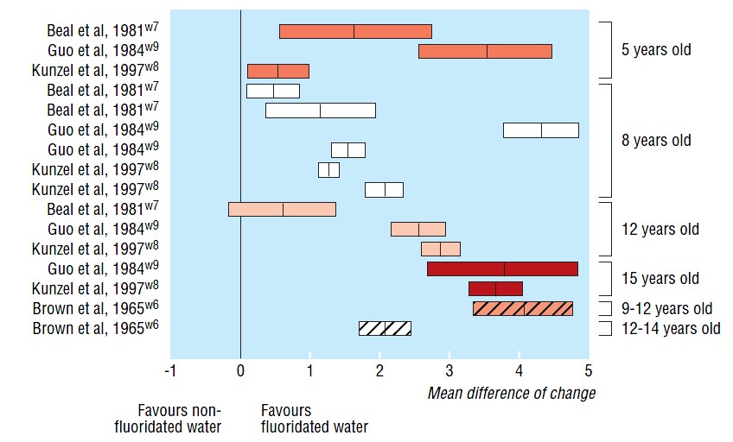
Change in decayed, missing, and filled teeth for primary/permanent teeth (mean difference and 95% confidence interval)
Source: Systematic review of water fluoridation. BMJ 2000;321;. McDonagh, M. et al
Notes:
Source: Systematic review of water fluoridation. BMJ 2000;321;. J. Kleijnen, Chestnutt, J. Cooper, K. Misso, et al.
1965 to 1997

Slide 66

Dental fluorosis
Dental fluorosis can occur with increased
levels of fluoride consumption.
  Fluorosis (mild): fine white streaks across
  the crowns of teeth.
The prevalence of visually apparent fluorosis is very low with community water fluoridation (0.5 to 0.8 ppm).
No increase in moderate / severe fluorosis with infant formula feeding.
The prevalence of moderate dental fluorosis in Canada is low, and declining since 1996.
  Findings and Recommendations of the Fluoride Expert Panel. Health Canada. January 2007:
  http://www.hc-sc.gc.ca/ewh-semt/pubs/water-eau/2008-fluoride-fluorure/index-eng.php
Notes:
66

Slide 67
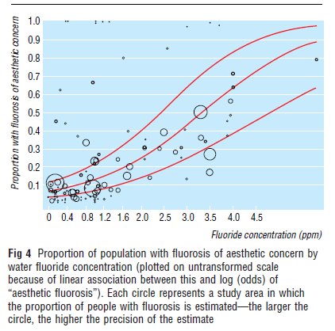
Notes:
67

Slide 68
Safety of water fluoridation
The evidence from research does not support a link between exposure to fluoride in drinking water at 1.5 ppm and any adverse health effects, including:
  Cancer
    McDonagh review (2000) of 26 studies: 24 found no increase, 1 found an increase, 1 found a reduction in cancer rates.
    Osteosarcoma – Bassin study (2006) found an increase for 7 y.o. boys - Douglas letter (2006), larger data set found no increase. Kim study (2011) with more accurate exposure measurements (bone fluoride concentrations) found no increase in cancer.
  Fluoride in Drinking Water. Prepared by the Federal-Provincial-Territorial Committee on Drinking Water. Health Canada. Comment period ended November 27, 2009: http://www.hc-sc.gc.ca/ewh-semt/consult/_2009/fluoride-fluorure/draft-ebauche-eng.php#t5
  An Assessment of Bone Fluoride and Osteosarcoma. Kim et al. J Dent Res 90(10):1171-1176, 2011.

Slide 70
Safety of water fluoridation
The evidence does not support a link between exposure to fluoride in drinking water at 1.5 ppm and any adverse health effects, including:
  Immunotoxicity
  Reproductive / developmental toxicity
  Genotoxicity
  Fractures / skeletal fluorosis
  Neurotoxicity / intelligence
    Studies of communities in China, Mexico – high fluoride concentrations, other causal factors (eg. lead, iodine) not reported.
    “There are significant concerns regarding the available studies, including quality, credibility, and methodological weaknesses.”
  Fluoride in Drinking Water. Prepared by the Federal-Provincial-Territorial Committee on Drinking Water. Health Canada. Comment period ended November 27, 2009: http://www.hc-sc.gc.ca/ewh-semt/consult/_2009/fluoride-fluorure/draft-ebauche-eng.php#t5
  Critical review of any new evidence on the hazard profile, health effects, and human exposure to fluoride and the fluoridating agents of drinking water. Scientific Committee on Health and Environmental Risks. European Commission. 2010.

Slide 71
Who supports CWF?
Orillia
Simcoe Muskoka District Health Unit Board of Health
Leadership Council of the North Simcoe Muskoka LHIN
Muskoka Simcoe Dental Society (including Orillia)
Orillia Soldiers’ Memorial Hospital
  Board of Directors
  Department of Family Medicine
  Department of Paediatric and Neonatal Medicine
  Medical Advisory Committee
Ontario
Ontario Association of Public Health Dentistry
Royal College of Dental Surgeons of Ontario
Chief Medical Officer of Health of Ontario
Ontario Medical Association
Association of Local Public Health Agencies (alPHa)
Ontario Dental Association
Ontario College of Dental Hygienists
Canada
Health Canada
Canadian Association of Public Health Dentistry
Canadian Dental Association
Canadian Public Health Association
Canadian Pediatric Society
Canadian Cancer Society
International
World Health Organization (WHO)
Pan American Health Organization (PAHO)
Centers for Disease Control and Prevention (CDC)
Recent US Surgeon General’s Report
Federation Dentaire Internationale (FDI)
American Cancer Society
American Medical / Dental Associations
Notes:
71

Slide 72
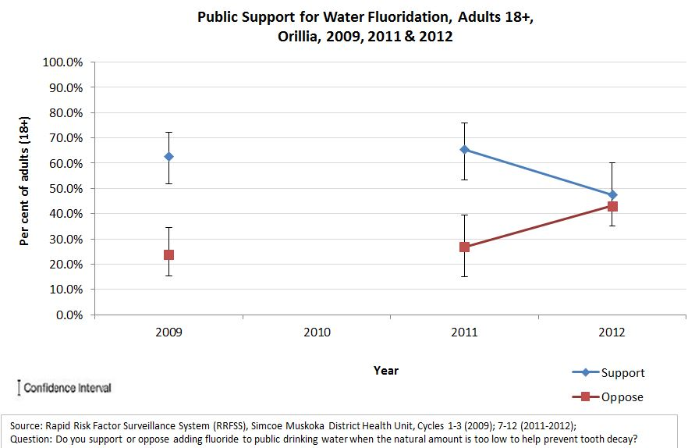
Public support for fluoridation
Public support for adding fluoride to municipal water in Orillia

Slide 73
Other considerations
Fluoridation is a collective solution to help reduce dental decay. Examples of other collective solutions:
    Treating water with chlorine to provide safe drinking water.
    Adding vitamin D to milk to prevent rickets and ensure healthy bones.
    Adding iodine to salt to ensure healthy physical and mental development.
    Adding folate the flour to prevent birth defects.
Inexpensive and cost effective. Every $1 invested in community water fluoridation yields about $38 in savings each year from fewer cavities treated.1
1. J Publ Health Dent 2001;61(2):78–86
Notes:
73

Slide 74
Outcomes
SMDHU assisted the City of Orillia in their review of community water fluoridation over a period of over 1 year, ending in July, 2012
The resulting City staff report recommended the implementation of community water fluoridation, based on its profile of safety, effectiveness, cost effectiveness, and health equity.
Physicians and dentists advocated for CWF as a means of improving dental health for their patients
Despite this, on July 16th, 2012 Orillia City Council voted against fluoridation
Lessons learned:
  Very difficult to simply maintain fluoridation, let alone introduce it in the Ontario setting (increasing coverage in the USA and Quebec)
  Possibly better to commence with Council with a broader focus on oral health as an issue?

